Slide 1

French Primary schools
The school day can vary between regions but is generally 8.30 am until
16.30 pm ,with two breaks and a long lunch hour
Traditionally many French primary schools closed on a Wednesday afternoon
having classes on a Saturday morning instead. This is no longer the case in
some primary schools
Some primary schools now do a 4 day week with 6 hours on a Monday,
Tuesday, Thursday and Friday.
The school holidays are very long from the beginning of July to the beginning
of September.... But they do have a long school day!

Slide 2
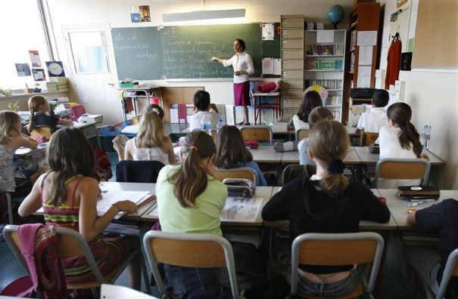
In France there is a national timetable and the focus is on key subjects:
Maths, French grammar, reading and writing and science.
There is not much emphasis on arts and other subjects.
Most days children will have a handwriting lesson, and all children are taught
to write in the same style.
There is homework every day in reading , writing and maths.
Children are tested and evaluated regularly and those who fall behind
may be required to repeat a year.

Slide 3
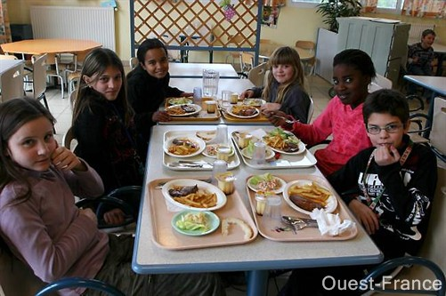
Lunch may vary from school to school but is generally 1 ½ to 2 hours long.
Children may either go home for their lunch or stay at school and eat in the
canteen.
Children do not have packed lunch but school meals are generally of a very good
quality.

Slide 4
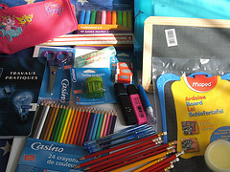
State schools are free but parents must supply stationary and additional funds
for school outings.
They are required to have a pencil case, rubber, pencil, pencil sharpener, scissors,
glue stick, coloured pencils, ruler, folder, mini blackboard, text books, gym shoes,
diary.
Homework is set daily in a diary. Any information between parents and school
is also written in the diary. It is a very important link .
With all the equipment and regular homework many children use a small pull along
case.

Slide 5
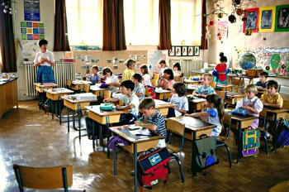
Children in French primary schools either sit at individual desks or in rows.
They do not have as many wall displays.
The expectations of the teachers is very high.
Some critics of the system say it is unimaginative , strict and boring.

Slide 6
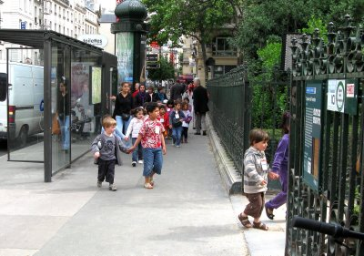
French school children do not wear a uniform unless it is a private school.

Slide 7
Can you think of any things that are similar and things that are different about French and English primary schools?

Slide 8
L.O- To learn about the similarities and differences between schools in France and England
French Primary Schools | English Primary Schools

